Slide 1


DATATECH LABS.
Data Engineering Course.
Week 4

Slide 2
Outline: Week 4
Advanced Spark Programming
Spark RDDs, DataFrames, and Datasets
Spark SQL and analytics
Machine learning with Spark MLlib
Streaming Data Processing
Introduction to stream processing concepts
Apache Kafka for real-time data ingestion
Stream processing with Apache Flink
DATATECH LABS.

Slide 3
Advanced Spark Programming
DATATECH LABS.

Slide 4
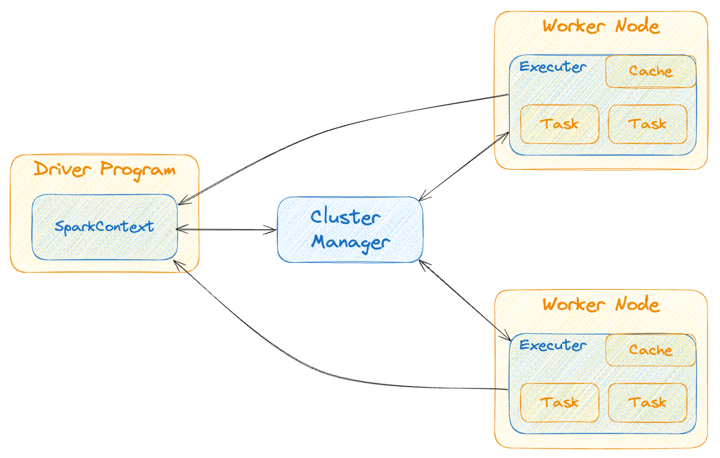
Spark Architecture (Recap)
Driver Program
Cluster Manager
Worker Nodes
Executors
Key features:
In-memory computation
Fault tolerance
Lazy evaluation
Support for multiple languages
(Scala, Java, Python, R)
DATATECH LABS.

Slide 5
Spark RDDs (Resilient Distributed Datasets)
Definition: Fundamental data structure of Spark
Essentially refers to a distributed collection of data records
Resilience Advantage is their fault-tolerant nature
Properties:
Immutable
Partitioned
Ability to be operated on in parallel
.sql
from pyspark import SparkContext, SparkConf
conf = SparkConf() \
.setAppName("parallelize_example") \
.setMaster("local[*]")
sc = SparkContext(conf=conf)
data = [1, 2, 3, 4, 5, 6, 7, 8, 9, 10]
rdd = sc. parallelize (data)
print(rdd.collect())
DATATECH LABS.

Slide 6
RDD Operations
Transformations (lazy operations):
map, flatMap, filter, distinct, sample
Actions (trigger execution):
collect, count, first, take, reduce
DATATECH LABS.

Slide 7
RDD Persistence
cache() and persist() methods
Storage levels:
MEMORY_ONLY
MEMORY_AND_DISK
DISK_ONLY
OFF_HEAP
DATATECH LABS.

Slide 8
Shared Variables in Spark
Broadcast variables
Read-only variables cached on each machine.
Accumulators
Variables that are only "added" to through an associative and commutative operation.
DATATECH LABS.

Slide 9
Spark DataFrames
Definition: Distributed collection of data organized into named columns
Advantages over RDDs:
Named columns
Optimized execution
SQL-like operations
DATATECH LABS.

Slide 10
Creating DataFrames
From RDDs
From a list of data
Reading from files (CSV, JSON, Parquet)
From Hive tables
DATATECH LABS.

Slide 11
DataFrame Operations
select(), filter(), groupBy()
join(), union(), orderBy()
withColumn(), drop()
agg() for aggregations
DATATECH LABS.

Slide 12
Spark SQL
Running SQL queries on DataFrames
Creating temporary views
Catalog API for managing tables and databases
DATATECH LABS.

Slide 13
Spark Datasets
Definition: Strongly-typed version of DataFrames
Benefits:
Type-safety
Lambda functions in queries
DATATECH LABS.

Slide 14
Working with Datasets
Creating Datasets
Dataset operations
Converting between DataFrames and Datasets
DATATECH LABS.

Slide 15
Machine Learning with Spark MLlib
Overview of MLlib
Supported algorithms:
Classification
Regression
Clustering
Collaborative filtering
DATATECH LABS.

Slide 16
MLlib Pipeline APIs
Transformers
Estimators
Parameters
Pipeline composition
DATATECH LABS.

Slide 17
GraphX for Graph Computation
Overview of GraphX
Key abstractions: Graph, VertexRDD, EdgeRDD
Graph operators and algorithms
DATATECH LABS.

Slide 18
Spark Performance Tuning
Data serialization
Memory tuning
Degree of parallelism
Data locality
Shuffle optimization
DATATECH LABS.

Slide 19
Hands-on:
Data Engineering.
DATATECH LABS.

Slide 20
Q&A and Discussion
DATATECH LABS.

Slide 21
Streaming Data Processing
DATATECH LABS.

Slide 22
Streaming Data Processing
DATATECH LABS.

Slide 23
Introduction to Streaming Data Processing
Definition: Processing data in real-time as it arrives
Importance in modern data architectures
DATATECH LABS.

Slide 24
Characteristics of Streaming Data
Continuous
Unbounded
Time-sensitive
High volume and velocity
DATATECH LABS.

Slide 25
Streaming vs. Batch Processing
.
Aspect | Streaming | Batch
Data processing | Real-time | Periodic
Latency | Low | High
Throughput | Lower | Higher
Complexity | Higher | Lower
Use cases | Real-time analytics, monitoring | Historical analysis, reporting
DATATECH LABS.

Slide 26
Streaming Data Processing Concepts
Event time vs. Processing time
Windowing
Watermarks
State management
DATATECH LABS.

Slide 27
Streaming Data Sources
IoT devices
Social media feeds
Financial market data
Web clicks and user activity
Logs and metrics
DATATECH LABS.

Slide 28
Streaming Processing Models
Record-at-a-time
Micro-batch
Hybrid
DATATECH LABS.

Slide 29
Data Streaming
Tools
DATATECH LABS.

Slide 30

Introduction to Apache Kafka
Definition: Distributed streaming platform
Key features:
Publish-subscribe messaging
Fault-tolerant storage
Stream processing
DATATECH LABS.

Slide 31
Kafka Architecture
Brokers
Topics and Partitions
Producers
Consumers and Consumer Groups
ZooKeeper
DATATECH LABS.

Slide 32
Kafka Topics and Partitions
Topics: Categories for organizing messages
Partitions: Units of parallelism within topics
[Visual: Topic and partition diagram]
DATATECH LABS.

Slide 33
Kafka Producers & Consumers
Kafka Producers:
Sending messages to topics
Partitioning strategies
Acknowledgment modes
Kafka Consumers
Subscribing to topics
Consumer groups for scalability
Offset management
DATATECH LABS.

Slide 34
Kafka Streams
Lightweight library for stream processing
Stateful and stateless operations
Exactly-once semantics
DATATECH LABS.

Slide 35

Spark Streaming
Definition: Extension of the core Spark API for processing live data streams
DStreams (Discretized Streams)
Input sources: Kafka, Flume, Kinesis, TCP sockets
DATATECH LABS.

Slide 36
Spark Streaming Operations
Transformations on DStreams
Window operations
Join operations
Output operations
DATATECH LABS.

Slide 37
Structured Streaming
Definition: Scalable and fault-tolerant stream processing built on the Spark SQL engine
Advantages over DStreams:
Simpler programming model
Stronger consistency guarantees
DATATECH LABS.

Slide 38
Structured Streaming Programming Model
Input sources
Operations and queries
Output sinks
Triggers and watermarking
DATATECH LABS.

Slide 39

Introduction to Apache Flink
Definition: Distributed processing engine for stateful computations over data streams
Key features:
Event time processing
Stateful computations
Exactly-once semantics
DATATECH LABS.

Slide 40
Flink Architecture
JobManager
TaskManagers
Client
DATATECH LABS.

Slide 41
Flink Programming Model
DataStream API
Table API and SQL
ProcessFunction for low-level operations
DATATECH LABS.

Slide 42
Flink Windows and Time
Types of windows:
Tumbling windows
Sliding windows
Session windows
Event time vs. Processing time
DATATECH LABS.

Slide 43
Flink State Management
Keyed state
Operator state
State backends (RocksDB, heap memory)
DATATECH LABS.

Slide 44
Flink Fault Tolerance
Checkpointing
Savepoints
Exactly-once guarantees
DATATECH LABS.

Slide 45
Comparison of Streaming Frameworks
Latency
Throughput
Fault tolerance
State management
Ecosystem integration
[Visual: Comparison table of Kafka Streams, Flink, and Spark Streaming]
DATATECH LABS.

Slide 46
Best Practices for Streaming Data Processing
Handling late and out-of-order data
Scaling and performance tuning
Monitoring and alerting
Data quality and validation in streams
DATATECH LABS.

Slide 47
Hands-on:
Data Engineering.
DATATECH LABS.

Slide 48
Q&A and Discussion
DATATECH LABS.

Slide 49

MEET OUR TEAM
Omar AlSaghier
Sr. Data Engineer
DATATECH LABS.

Slide 50







DATATECH LABS.
THANK YOU
OUR CONTACT
DataTechLabs
datatechlabs.ai@gmail.com
datatechlabs.ai
Amman, Jordan

